Slide 1
Refresher Mathematics and Statistics in Python
Class 5

Slide 2
Learning Goals Today
After today you should understand:
1. The basics of Inferential Statistics
2. Sampling Distributions
3. Confidence Intervals
4. Hypothesis Testing

Slide 3


Sometimes, webshops try out new features to see if it increases sales
Let’s say you are in charge of testing whether implementing the above change in layout has an effect on increasing revenue
How would you prove that it works?
https://blog.hubspot.com/marketing/a-b-testing-experiments-examples
Notes:
This is just an introduction to show what kind of practical problems can be solved using inferential statistics

Slide 4
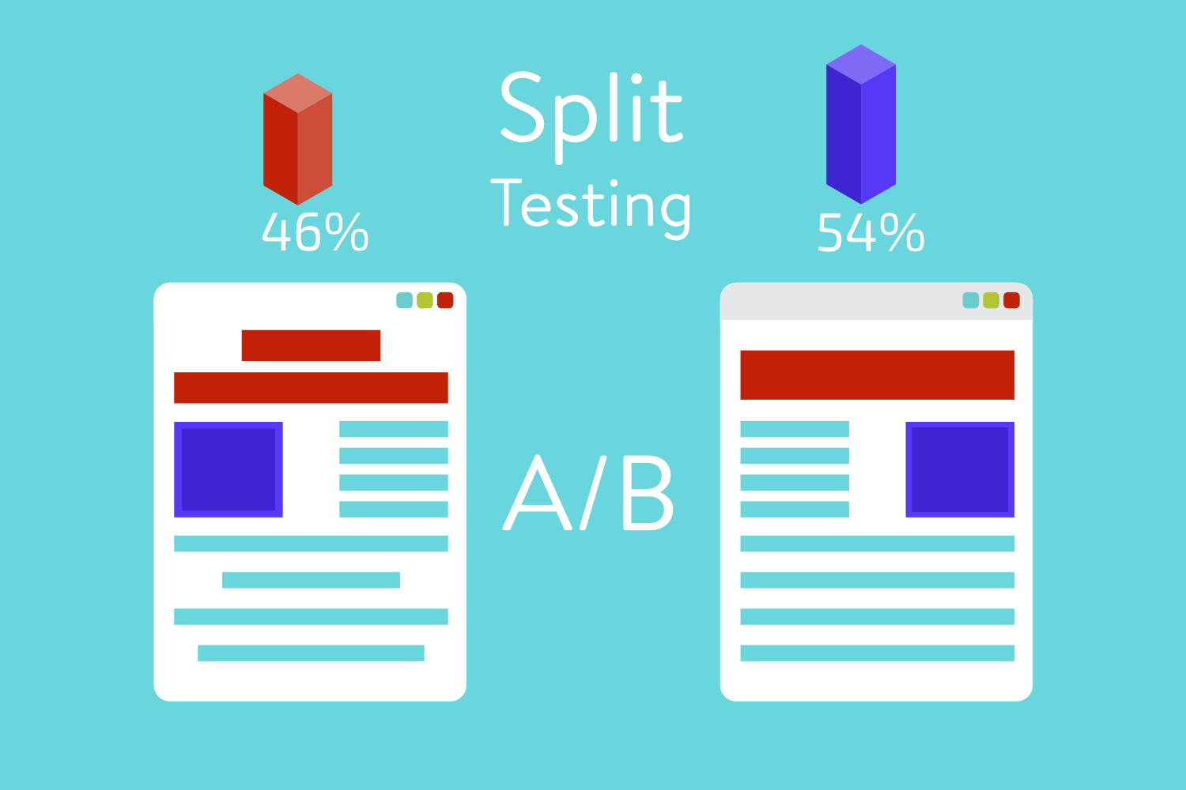
Step 1: gathering data
Many websites use a method called A/B testing
How would you gather data to test whether it works?
Solution: randomly assign visitors to websites and see if there is a difference
Notes:
https://kinsta.com/wp-content/uploads/2015/05/ab-split-testing-1.png

Slide 5
Step 2: Comparing results
Let’s say that on version 2 of the website customer spend on average 50 cents more. You find that the increase cannot be attributed to the time or day that the new website was published.
Does this prove that the increase is because of the change of layout?

Slide 6
Step 2: Comparing results
The problem is: the difference in revenue could just be because of random chance because there is always some variation going on.
So how do you know that a difference in revenue is because of the layout, or because of random chance?

Slide 7
Proving a link
If we want to prove that something works based on sample data, we have to account for the influence of random variation
We can account for this using:
Sampling Distributions

Slide 8
Sampling Errors

Slide 9
Sampling Error
In Statistics we estimate what the Population looks like based on the Sample
Sample statistics
(known)
Population Statistics
(unknown, but can be estimated from sample evidence)
Inference

Slide 10
Sampling Error
The problem is:
The sample mean will never be exactly the same as the population mean
This difference between the sample and the population is called the
ERROR
→ It is literally an error in the sampling

Slide 11

Sampling Error
Therefore if:
$\overline{x}$ = Sample Mean
And
µ = Population Mean
Then
Sampling Error = $\overline{x}$ - µ

Slide 12
Sampling Distributions

Slide 13
Sampling Distributions
Suppose I have a Population of the grades of 5 students:
3, 4.2, 5.5, 7.1, 8.6
And we calculate all sample means (n=2), and put them in a histogram we get this:

Slide 14
Sampling Distributions
If you put together all of the means of all possible samples (of the same sample size) you get the:
Sampling Distribution
→ It shows the distribution of all the Means of all the Samples

Slide 15
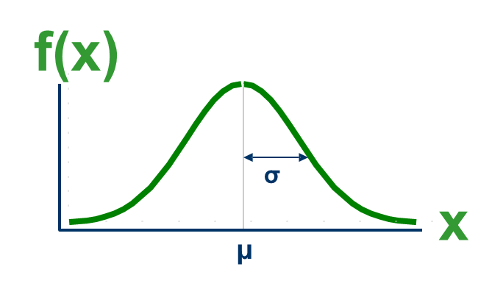
Sampling Distribution
If the population is normally distributed, then the Sampling Distribution also has the shape of a Normal Distribution
µ = Mean (Mu)
σ = Standard Deviation (Sigma)

Slide 16
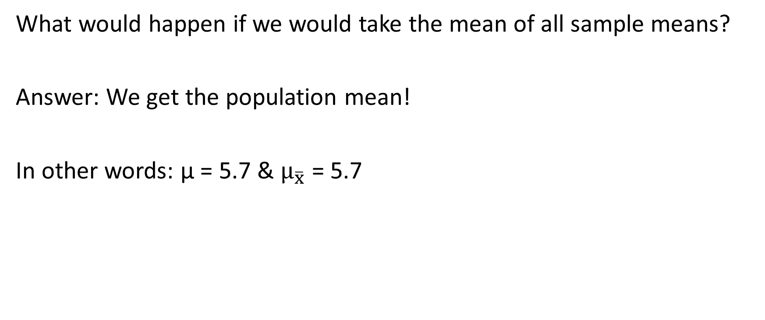
Sampling Distribution: Mean
What would happen if we would take the mean of all sample means?
Answer: We get the population mean!
In other words: µ = 5.7 & $μ_{\overline{x}}$ = 5.7

Slide 17
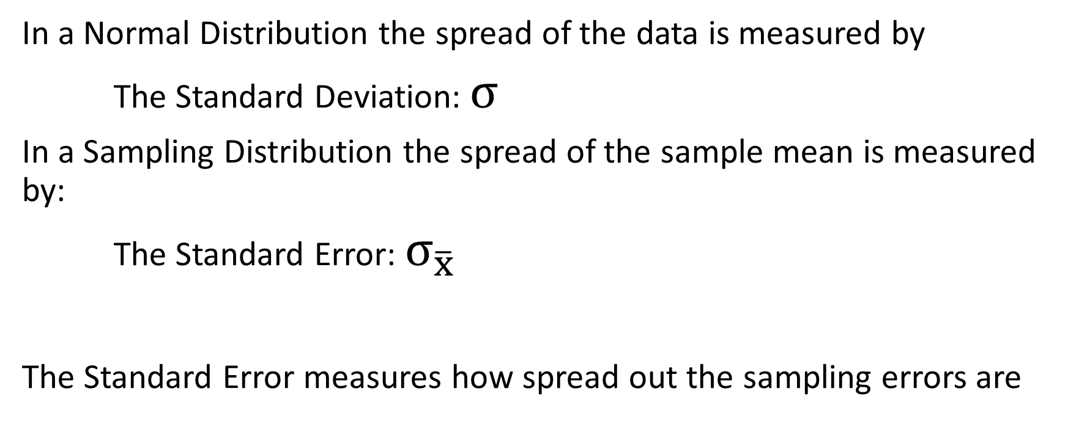
Sampling Distribution: Spread
In a Normal Distribution the spread of the data is measured by
The Standard Deviation: $σ$
In a Sampling Distribution the spread of the sample mean is measured by:
The Standard Error: $σ_{\overline{x}}$
The Standard Error measures how spread out the sampling errors are

Slide 18
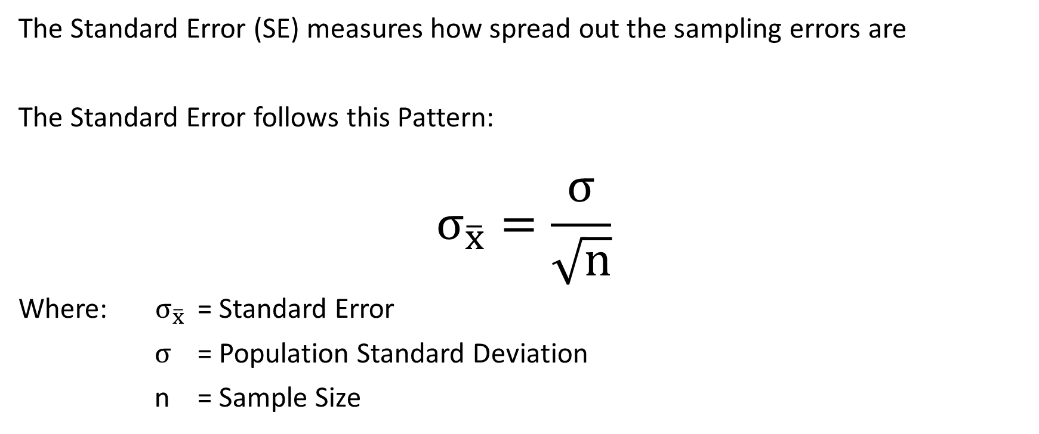
Standard Error
The Standard Error (SE) measures how spread out the sampling errors are
The Standard Error follows this Pattern:
$$σ_{\overline{x}}=\frac{σ}{\sqrt{n}}$$
Where: $σ_{\overline{x}}$ = Standard Error
$σ$ = Population Standard Deviation
n = Sample Size

Slide 19

Standard Error and Sample Size
$σ_{\overline{x}}=\frac{σ}{\sqrt{n}}$
Square Root of Sample Size
The Bigger the Sample Size, The smaller the Standard Error

Slide 20

Standard Error and Sample Size
$$σ_{\overline{x}}=\frac{σ}{\sqrt{n}}$$
The Implication of this is:
1. The larger your sample size, the less likely you will have a large sampling error
2. The more likely your estimate will be close to the population value

Slide 21
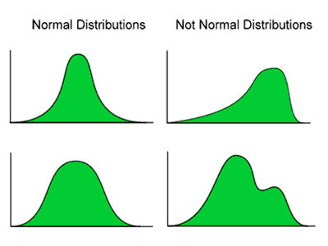
Central Limit Theorem (1)
We can calculate probabilities with a sample
distribution
But: this only works if we have a
Normal Distribution
Sampling Distributions often have a similar shape
as the population distribution
This means that we can’t do the calculations if the population is not normally distributed ☹
Image Source: http://pip.ucalgary.ca/psyc-312/introduction-to-hypothesis-testing/the-normal-distribution/definition.html

Slide 22
Central Limit Theorem (2)
There is a work-around this problem:
The larger the sample size, the more the sampling distribution looks like a
Normal Distribution
Therefore, if the sample size is big enough it is not longer a problem that the population is not a normal distribution
And we can do our calculations ☺

Slide 23

Central Limit Theorem (3)
the sampling distribution becomes almost normal regardless of shape of population
As the sample size gets large enough…
n↑
x

Slide 24
Central Limit Theorem (4)
How large should your sample size be?
The less your population is like a normal distribution
The larger your sample size needs to be
BUT
A sample size of 31 (n=31) is large enough for almost all populations

Slide 25
Central Limit Theorem (5)
Why is this so important?
Because it means that we can effectively use the normal distribution to simulate the sampling distribution, without having to know anything about the population!

Slide 26
Simulation
https://onlinestatbook.com/stat_sim/sampling_dist/
< I use this website to show that the sampling distribution becomes normal (and also narrower) as the sample size increases, regardless of the population distribution. However, the book does the same simulation in python so I would work with that >

Slide 27
Confidence Intervals

Slide 28
Sampling Errors
If we take a Random Sample there will always be some difference between the Mean of this sample and the Mean of the Population
The difference between these two means is the Sampling Error
Even though the actual sampling error is unknown, we can simulate its behavior using a normal distribution

Slide 29
Confidence Intervals
Based on a sampling distribution we can calculate a range in which we are most likely to find the population mean
We can use a sample to approximate what the value of the population could be, and to give use an idea of how accurate our estimation is

Slide 30

Confidence Interval: General Formula
95% confidence interval:
$$μ±1.96∗ \frac{σ}{\sqrt{n}}$$
Where:
$μ$= Sample Mean
$σ$ = Population standard deviation
n = sample size

Slide 31
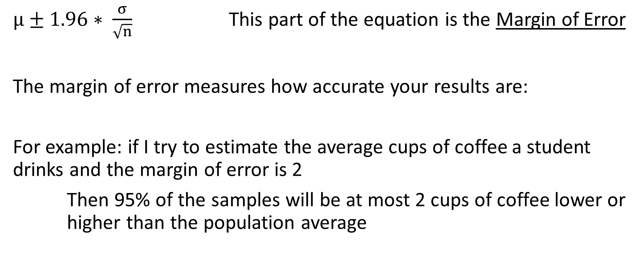
Confidence Interval: Margin of Error
$μ±1.96∗ \frac{σ}{\sqrt{n}}$ This part of the equation is the Margin of Error
The margin of error measures how accurate your results are:
For example: if I try to estimate the average cups of coffee a student drinks and the margin of error is 2
Then 95% of the samples will be at most 2 cups of coffee lower or higher than the population average

Slide 32
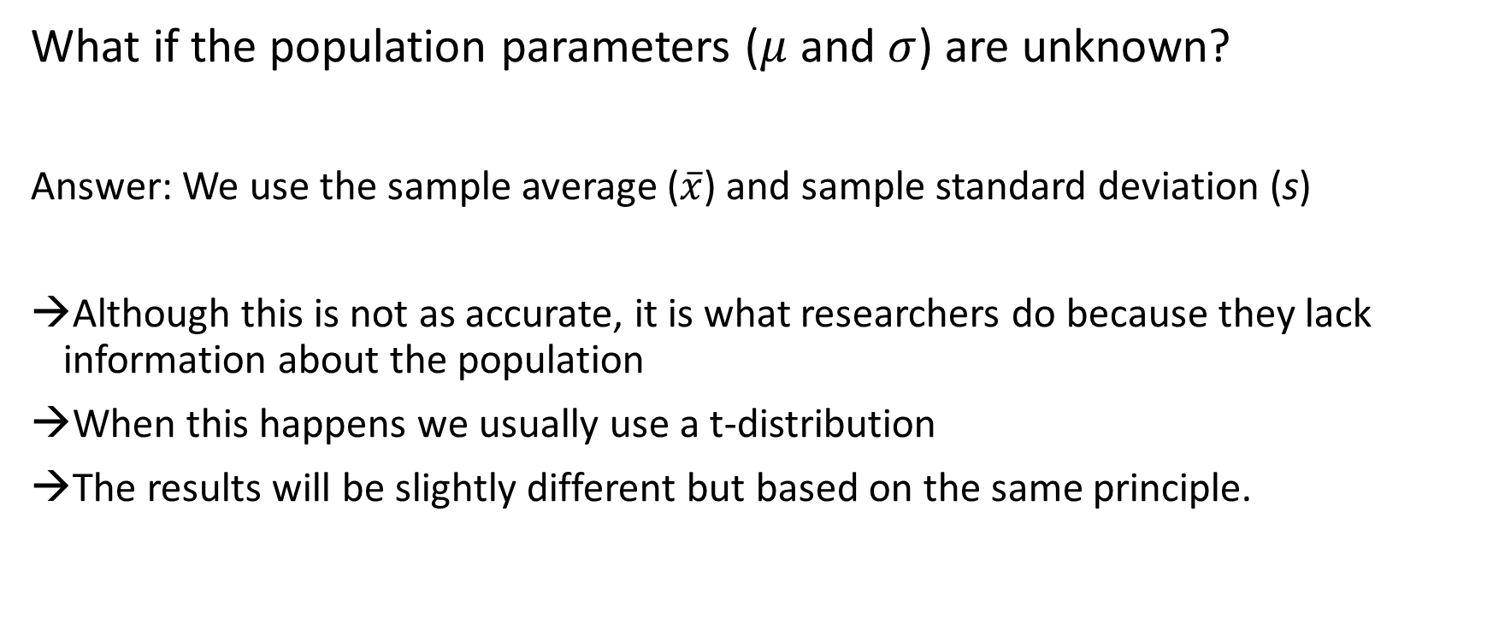
Population unknown
What if the population parameters ($μ$ and $σ$) are unknown?
Answer: We use the sample average ($\overline{x}$) and sample standard deviation (s)
Although this is not as accurate, it is what researchers do because they lack information about the population
When this happens we usually use a t-distribution
The results will be slightly different but based on the same principle.

Slide 33
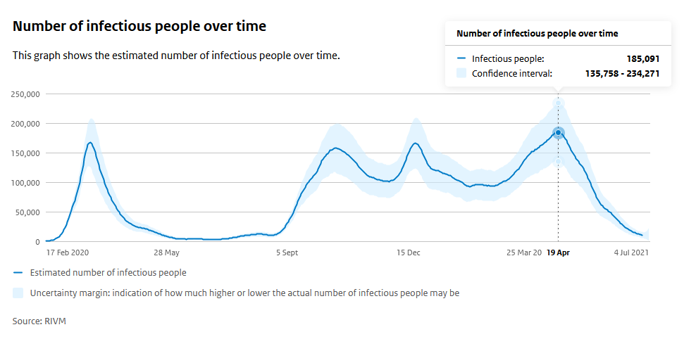
Notes:
This is a clear example from RIVM. They used samples to measure the number of infectious people and then calculate a confidence interval to show a plausible range of where it could be found. I took a screenshot because unfortunately the webpage is not up anymore.

Slide 34
Calculating the confidence Interval in Python
< An explanation of how the confidence interval can be calculated should be placed here. The book uses a fairly complicated script, but my suggestion is to just use the scipy package >
< See: https://www.statology.org/confidence-intervals-python/ >

Slide 35
Exercise 1
Open the file insurance.csv again
Calculate a 95% confidence interval for the variable charges. What do the results tell you about the average hospital charges of patients that are not in the data?
If you had data about only 15 patients, would you also be able to correctly calculate a confidence interval?

Slide 36
Exercise 1 solutions
The confidence interval is 12621 – 13920. This means that we can be 95% confident that the real average hospital charges of the population of patients is somewhere in between $12,621 and $13,920
No, the distribution of charges in clearly non-normal so you will need a sample size of at least 31 before we can assume the sampling distribution is normal
(see central limit theorem)
< The graph is made in Excel but of course needs
To be replicated in Python >

Slide 37
Hypothesis Testing

Slide 38
Hypothesis testing
We can also use sampling distributions to test claims about the population using the data in our sample
We call this hypothesis testing

Slide 39
Hypothesis testing how it works
If we go back to the example of hello fresh, we can use a sampling distribution to test whether the change in layout really led to a change in revenue of €0.50
(and that this is not simply because of random chance)

Slide 40
Hypothesis testing: step 1
The first thing we do is set up the hypothesis we want to prove:
The hypothesis: The change in layout has led to an increase in revenue

Slide 41
Hypothesis testing: step 2
The second step is to set up the null hypothesis which is the opposite of the hypothesis we are trying to prove (you’ll understand why in a bit)
Null hypothesis: The change in layout did not affect the revenue

Slide 42
Hypothesis testing: step 3
The third step is to simulate the sampling distribution in a world where the null hypothesis is true
Let’s say we have 150 measurements, and that the standard deviation (s) in the sample is 3 euros

Slide 43
Hypothesis testing: step 3
The mean of the sampling distribution is the change in revenue if the null hypothesis is true (so 0)
Mean = 0

Slide 44

Hypothesis testing: step 3
The standard deviation of the sampling distribution (called the standard error) =
Standard error = $\frac{s}{\sqrt{n}}$ = $\frac{3}{\sqrt{150}}$ = 0.245

Slide 45
Hypothesis testing: step 4
The final step is calculating the probability of finding an increase of €0.50 in your sample, if we assume that the null hypothesis is true
Or in math language P(sample data|null hypothesis)

Slide 46
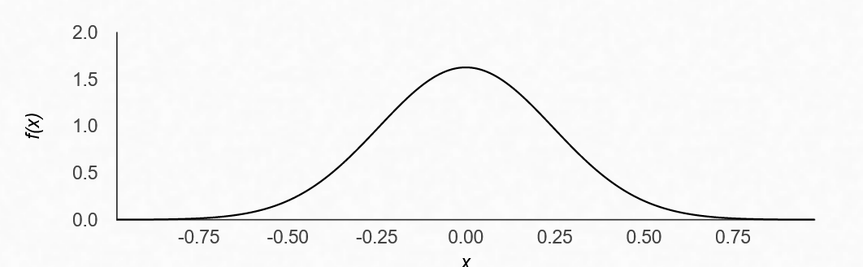
Hypothesis testing: step 4
This is what the sampling distribution looks like when the null hypothesis is true. You can see most samples are close to 0. Our sample (0.50) is pretty far from 0 though.
Taken from: https://homepage.divms.uiowa.edu/~mbognar/applets/normal.html

Slide 47
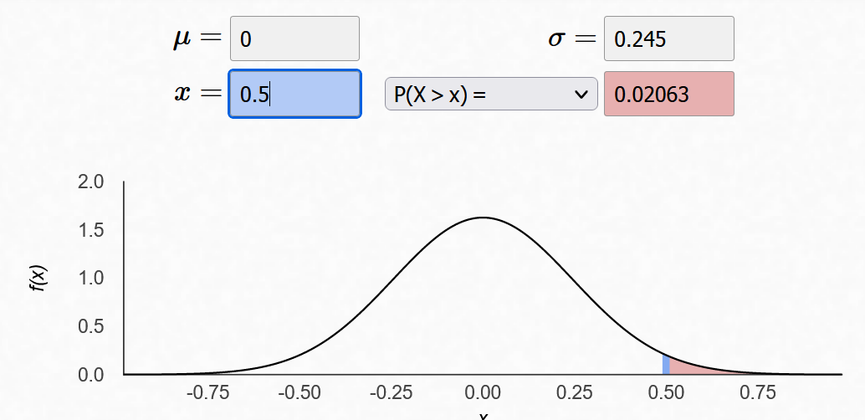
Hypothesis testing: step 4
The probability of finding a sample that is at least €0.50 higher is only 0.02063
Taken from: https://homepage.divms.uiowa.edu/~mbognar/applets/normal.html

Slide 48
Hypothesis testing: step 5
It’s time to draw our conclusions
Option 1: the change in layout has had no influence on the revenue and it was just because of random chance that we found an increase of €0.50
Option 2: the change in layout did lead to an increase revenue, also outside the data (this was our original hypothesis)
We just calculated the probability of option 1 (0.02063), and because this is so small, we reject this option in favor of option 2.
Therefore, we conclude that we have evidence that the change in layout worked!

Slide 49
P-value
This probability we just calculated is known as the
Generally, we say that if the p-value is smaller than 0.05 we call our result statistically significant and we take it as proof for our hypothesis
P-value
Notes:
Fancy word art

Slide 50
Hypothesis testing recap
Step 1: Determine your hypothesis
Step 2: Determine the null hypothesis
Step 3: Simulate a sampling distribution under the null hypothesis
Step 4: Calculate the p-value (the probability of finding your sample data using null hypothesis sampling distribution)
Step 5: if the p-value is < 0.05 accept your hypothesis in step 1

Slide 51
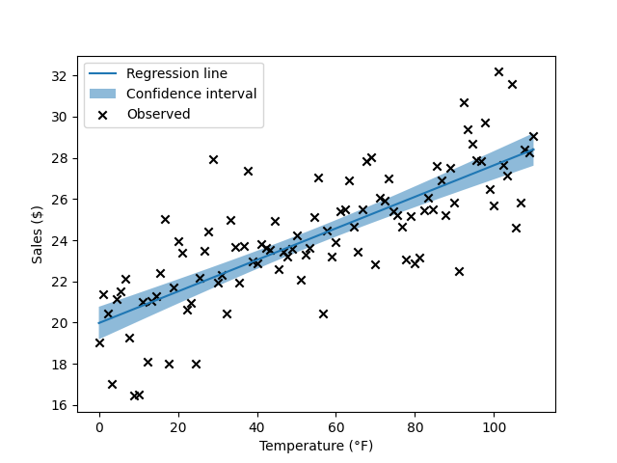
P-value
The p-value is not only used for hypotheses about averages
In regression models, the null hypothesis is that the slope in the population is 0
So the p-value in regression is the probability of finding a slope coefficient like the one in your data, if we assume that the slope in the population is 0.
Notes:
So if the p-value is smaller than 0.05 we conclude that the relationship between the variables is not just because of random chance but because it probably reflects a real relationship between the variables in the population.
Image source: https://lmc2179.github.io/posts/confidence_prediction.html

Slide 52
t-test
The most common method of testing a difference if an average is different from the null-hypothesis is the t-test.
It works very similarly to what we have done to test whether the change in layout had an effect in revenue.
The only difference is that it uses a t-distribution to calculate the probabilities instead of a normal distribution

Slide 53
Hypothesis testing in python
< The book calculates it manually, but I would just the functions in the scipy package: >
https://docs.scipy.org/doc/scipy/reference/generated/scipy.stats.ttest_1samp.html
https://docs.scipy.org/doc/scipy/reference/generated/scipy.stats.ttest_ind.html

Slide 54
Exercise 2
Open the file StudentsPerformance.csv. It contains data of American high school students and their grades for various subjects.
Last year, the average grade for math was 65.8. Test the hypothesis that this year it has increased.
The students can participate in a test preparation course. Test the hypothesis that the student who did so scored higher on the math exam.

Slide 55
Exercise 2 solutions
The average math score is 66.089. However, the p-value is not smaller than 0.05 so we have no evidence that it has increased
The students who participated in the prep course scored more than 5 points higher. The difference is also statistically significant so participating in the course might improve your grade
Notes:
Of course, an alternative explanation is that students who participated in the prep course were more motivated to begin with and would have also gotten higher grades regardless of the prep course.

Slide 56
Homework
Read the remainder of chapter 3 and do the exercises

